Slide 1
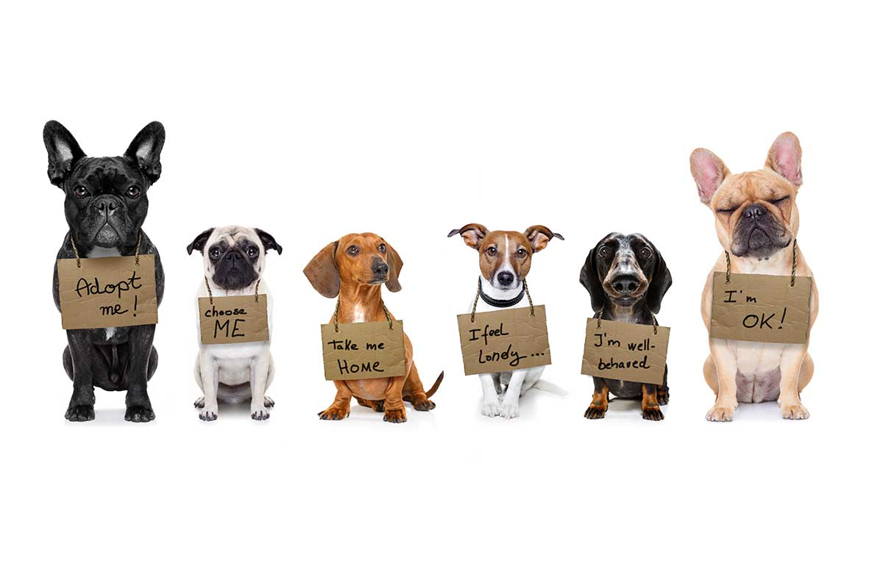
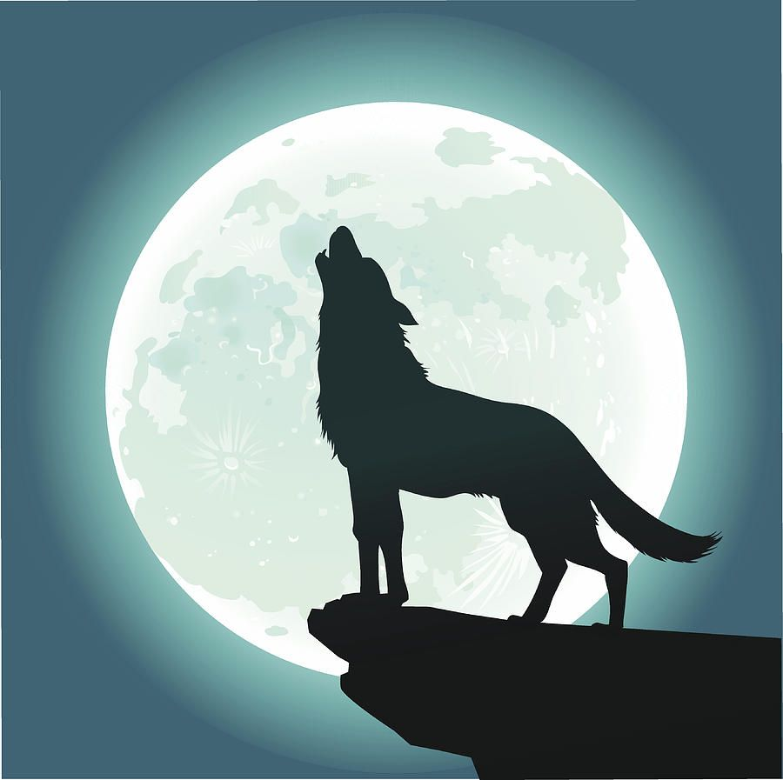
Bark Side of the Moon
created by:
Jack Loveday
Lakyn Felix
Mike Obasogie
Adam Girard-McFadden

Slide 2
Elevator Pitch
Have you ever wanted to find your next fur-ever friend and found it difficult to connect to animals in need that fit your requirements?
Our site connects potential pet owners to rescue organizations that provide all the data one could need on each adoptable pet so that the new owners can make informed decisions before bringing a fur-friend home.

Slide 3
Concept - Description
GIVEN an pet adoption website
WHEN I visit the home page
THEN I am welcomed to the website where I can search for adoptable cats and dogs
WHEN I click on the login/signup button
THEN a modal appears and prompts me to either login or signup with my credentials
WHEN I click on the submit button
THEN my credentials are verified and if approved, I am redirected to the home page but with Dashboard, Adoption Form and Donations tab available
THEN I can save adoptable pets to my dashboard so that I may review them again later, and compare prospective pets
When I search for pets on the home page once more
WHEN I click on the Dashboard tab
THEN I am presented with all the pets I have saved

Slide 4
Concept – cont’d
WHEN I visit the adoption form
THEN I am presented with a contact form
WHEN I enter my information in the form and click Submit
THEN an email is sent to the website owner so that they may get in touch with me
THEN donations…..
WHEN donations ……
THEN I am logged out of my account and my dashboard, adoption form and donations pages are not longer available
WHEN I click on Logout
WHEN I visit the Calendar page
THEN I am presented with a calendar of the current month with a cursor on the current date.

Slide 5
Concept - User Story 1
AS someone who loves to cats, but does not have the time to deal with animals that have specific medical needs
I WANT an application that will allow me to easily find cats that are available to adopt but also allows me to see their detailed information
SO THAT I can find cats that are right for me

Slide 6
Concept - User Story 2
AS a animal rights activist in my community that helps connect pets to good owners
I WANT an application that will allow me to filter animals by species and to easily identify each animals specific details
SO THAT when I connect prospective pet owners to their new pets, they are correctly matched and the animal isn’t returned to a shelter

Slide 7
Concept – cont’d.
Motivation for development
We all decided we loved the idea of connecting pet lovers to adoptable pets.
We also realized early on that the due date on the project was coming quickly and could not afford to stray very far from what we had practiced in class and with the modules. This app would resemble in some way apps we had already built and help ensure our success.

Slide 8
Process – Contribution Highlight
Jack
Lakyn
Mike
Adam
Backend, Authentication (JWT),
React –
Navigation, Login/Signup
Fetching and displaying information from the PetFinder API
React – Homepage, Dashboard, Donations (Stripe)
React – Footer
Index.css
ReadMe

Slide 9
Process – Built with
Languages Used
Application Build Type
MERN - SPA
HMTL
CSS
MongoDB/GraphQL
JavaScript + JSX
Express.js
React.js
Licence
Node.js
Many more NPM packages
Massachusetts Institute of Technology (MIT)

Slide 10
Process - cont.
Challenges
Successes
Great communication throughout the project
Fetch: PetFinder
Fetching data
Seemless github control between group members
Getting data to render into “pet” cards
Quickly realizing the short timeline for delivery and choosing an app that would be like other apps we built to help ensure that we have an MVP by presentations
Stripe (Donations)
A lot of the background work completed
Could not get it to work correctly
For Starters

Slide 11
Demo

Slide 12
Directions for Future Development
We will filter search results so that only pets in the user’s area display
Set up the app with Stripe and the required payment protection to accept donations
V 1.0
V 2.0
V 3.0

Slide 13

Deployed : https://cryptic-hollows-09419.herokuapp.com/
GitHub Repo : https://github.com/adamgmcfadden/Bark-Side-of-the-Moon

